Slide 1
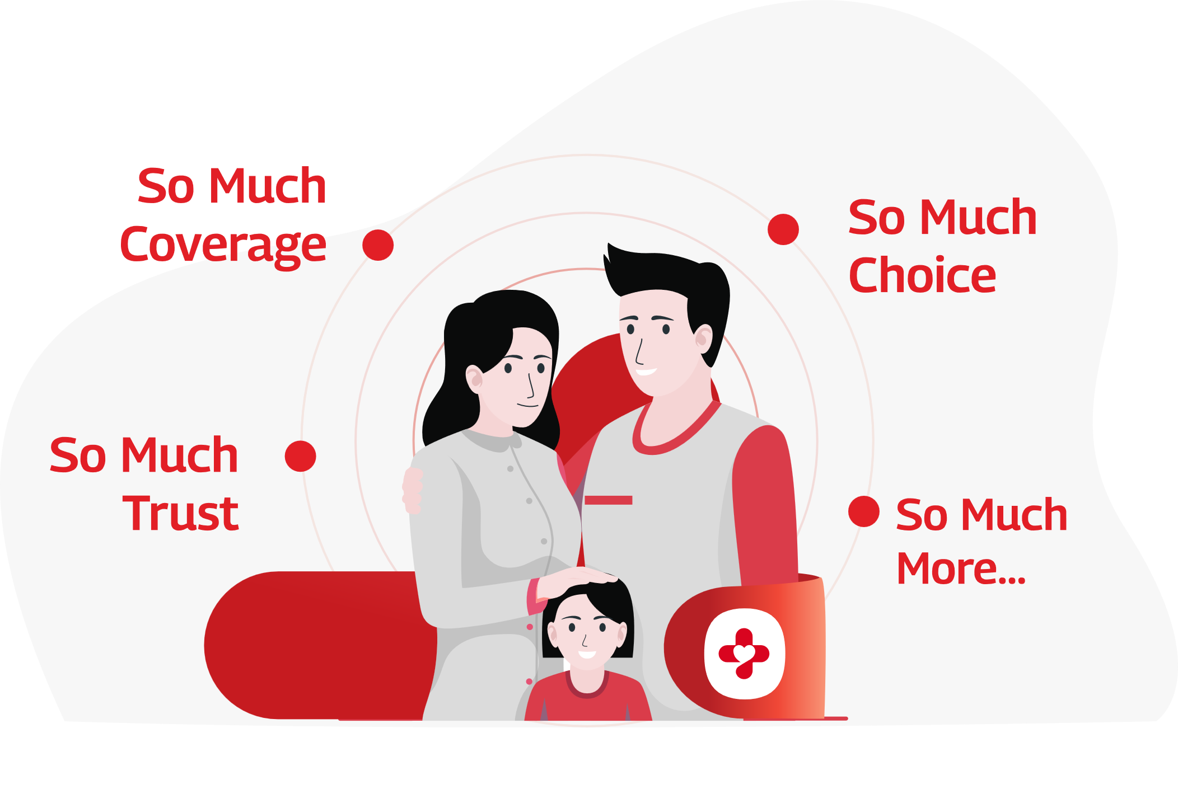
CAPSTONE PROJECT INTERIM PRESENTATION
Mentored by : Mr. Jayveer Nanda
BHAVYA SHARMA
GAGAN BHATT
SIDDHANT
PRADUM KAKRAN
ROHIT DAHIYA
VIVEK SINGH
ANMOL BHATIA

Slide 2
EXPLAINING THE PROBLEM STATEMENT:
Healthy India, also known as the Pradhan Mantri Health Yojana (PMHY), is a nationwide scheme that aims to help economically vulnerable Indians who are in need of healthcare facilities. This yojana plans to provide financial protection to the families below poverty line by providing coverage for critical systems like Heart, Lung, Liver, Pancreas, etc. The government has made all the transactions cashless for covered procedures.
The aim is to help as many people as possible who fall below the poverty line and to make the healthcare system more accessible to people who struggle financially
We , as data scientists are now presented with a dataset of the massive state of Andhra Pradesh which includes the details of the people that have already been provided the claim , and now we have been handed a task to predict whether the claim provided to people benefited them or not.
Our task is to predict that , if provided with the claim , what are the chances of saving people’s lives which , obviously is the main reason to pull up the funds for this scheme

Slide 3
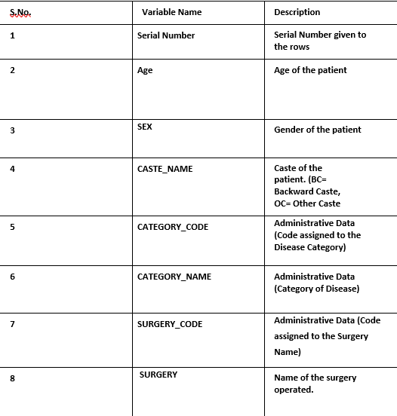
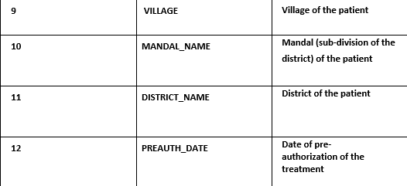
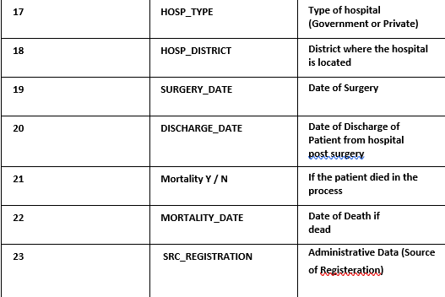
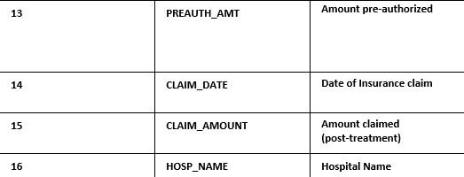
THE DATA DICTIONARY :

Slide 4
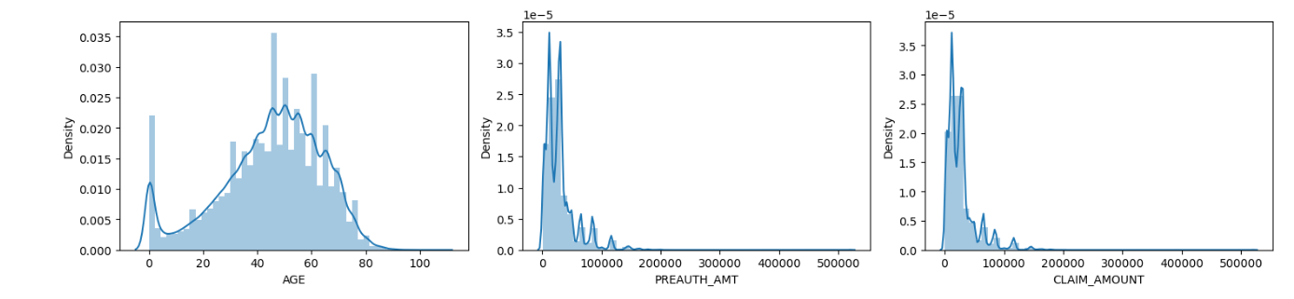
UNI-VARIATE ANALYSIS: NUMERICAL COLUMNS
The analysis shows that new born infants have a very high chance of taking a claim , then we can see that after
Turning 20 , people take more claims and people aged 40-60 take the most claims
We can also conclude that most claim requests are below 100000
Claim Amount also shows the same pattern as pre-auth amount

Slide 5
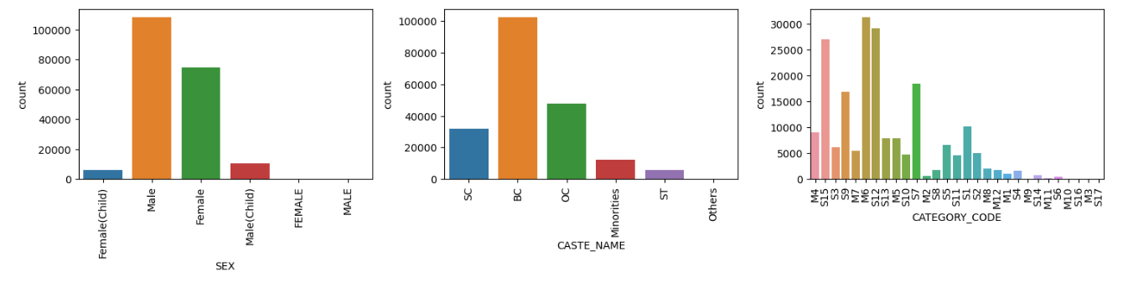
UNI-VARIATE ANALYSIS: CATEGORICAL COLUMNS
The gender column shows that males have taken more claims than females followed by the children
Backword caste people have taken the most claims and hence government should focus more on them.
Category codes need some feature extraction which we will handle at the later stages.

Slide 6
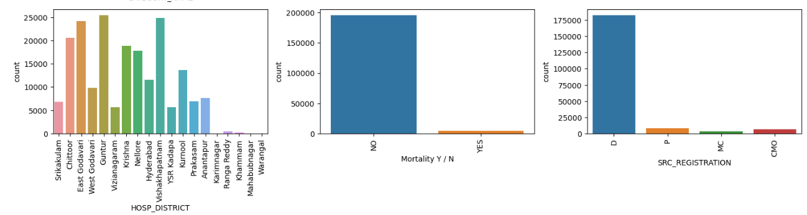
1. Not many inferences can be taken from the hospital district column , but we will deal it in the feature engineering
Section
2. Mortality rate is our target variable , it shows that most people survived which is a fantastic sign for the scheme.
3. SRC registration needs feature extraction and will be dealt later

Slide 7
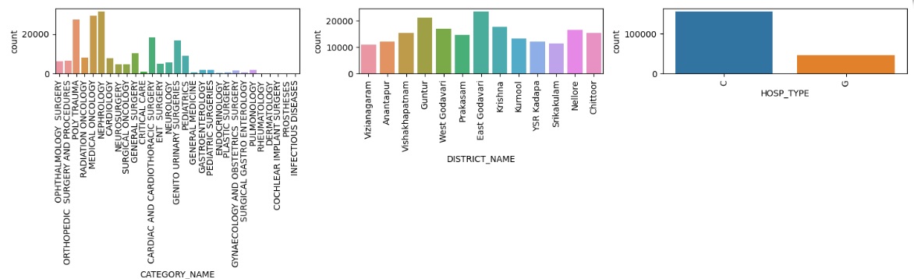
Category names clearly signify that more fatal diseases like kidney ,cancer and heart diseases are more likely to be claim
Candidates, Interestingly we have many poly trauma victims too (Accident-victims)
2. District names give no clear insight as of now
3. Hospital type clearly shows that C-Private hospitals have significantly received more claims

Slide 8
OUTLIER TREATMENT
MISSING VALUES
In insurance data ,specially our data , the outliers simply cannot be ignored because all people , regardless of what background they are from , should be provided with an insurance
Two Columns had missing values:
1.Mortality-Date- As 99% people
Survived , there was no value of mortality date , so we simply dropped the column.
2.Discharge date-This column had 1800+ missing values , so we simply calculated the mean difference of surgery date and discharge date to find out , how many days does it take to get discharged , and added it to the respective surgery dates of the patients whose discharge data was missing.

Slide 9
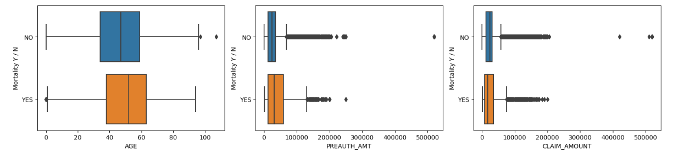
BI-VARIATE ANALYSIS(NUMERICAL COLUMNS)
1.People aged more have a higher chance to die and hence , should be given priority
2. People who took higher claims survived more , fantastic sign for the scheme
3. Claim amount shows the same insight as the pre-auth amount

Slide 10
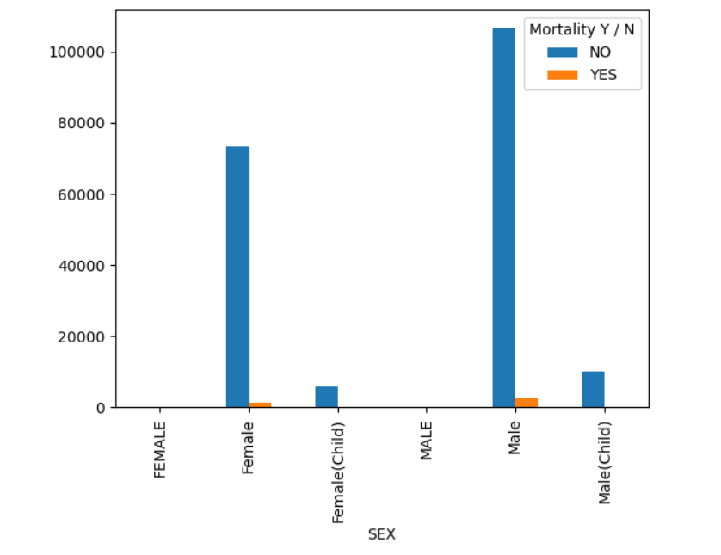
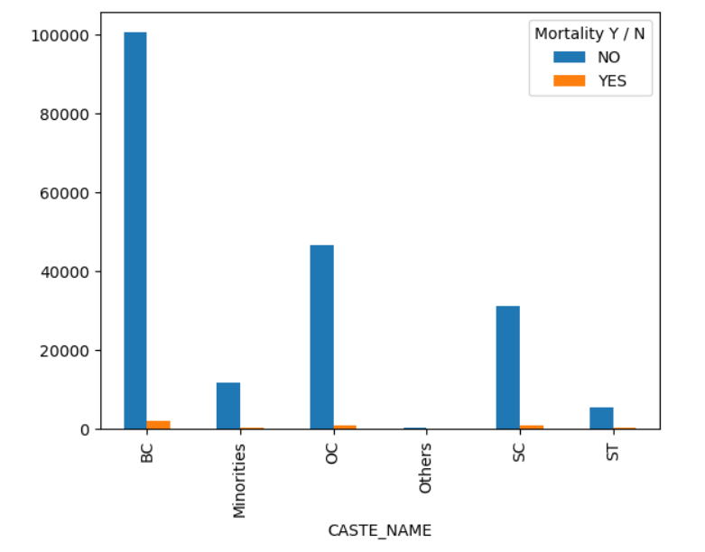
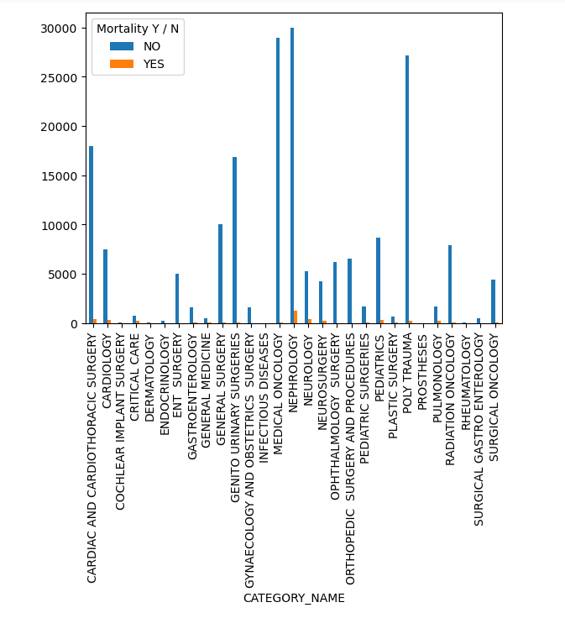
BI-VARIATE ANALYSIS(CATEGORICAL COLUMNS)
1. Males are more likely to die than females and children.
2. Backward class people are more likely to die than others
3. Fatal diseases have a higher chance of killing the patient which should be quite obvious regardless.

Slide 11
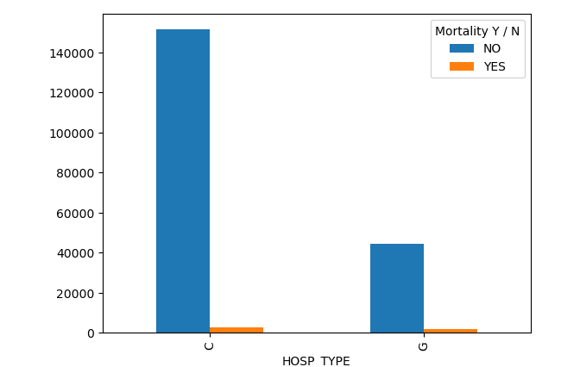
More people die in the private hospitals but the ratio is quite High in the government hospitals which clearly shows that even
After receiving insurance claims, patients are suffering because Of poor infrastructure in government hospitals
The plot based analysis provided by matplot library and seaborn show good insights but are limited in nature because
There is only so much you can show In a picture , rest of the column needs some business and technical
transformation so that Intelligence can be mined from them , hence we need feature engineering
Outliers were not treated in this dataset because

Slide 12
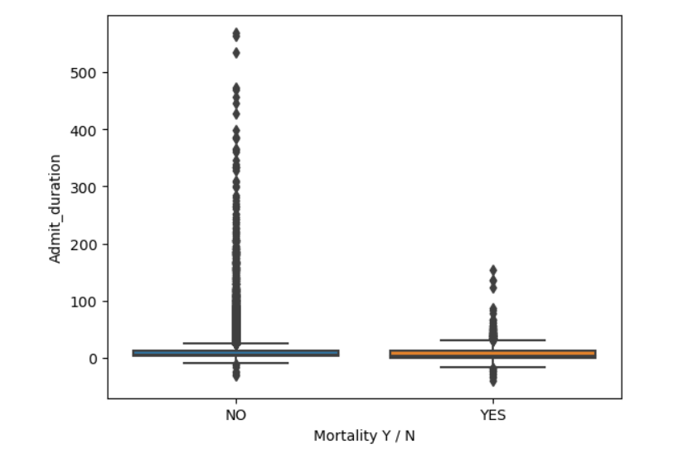
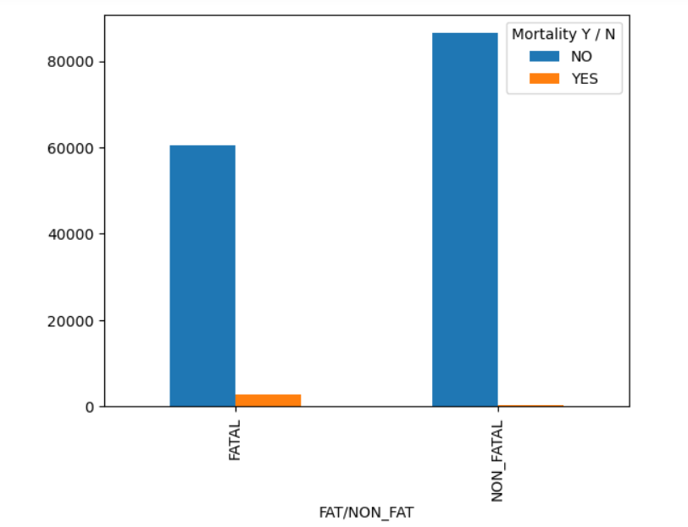
FEATURE ENGINEERING
We were given the discharge date and the pre auth
Date (a form filed on the date of admission), so we
Took their difference and found the admit duration of
a patient , this feature gives us the inference that the
Patients who stayed longer in the hospital have a higher
Chance of surviving than the ones who stayed for lesser
time.
Based on the number of people dying per disease,
We created a new feature , where we divided the
Diseases into fatal and non fatal , and we saw that
People with fatal diseases are more likely to die.

Slide 13
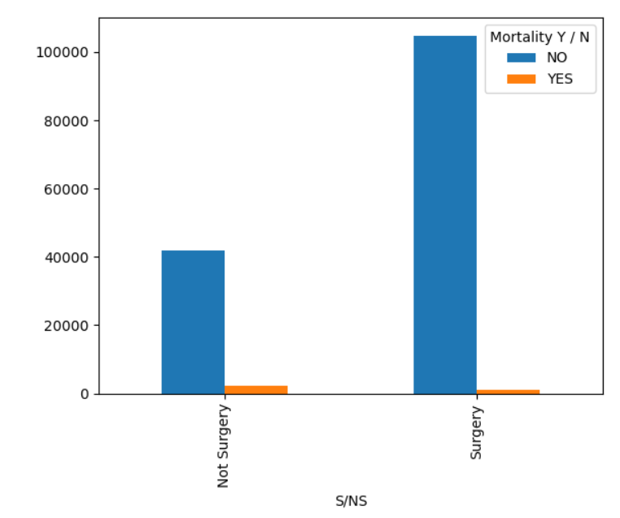
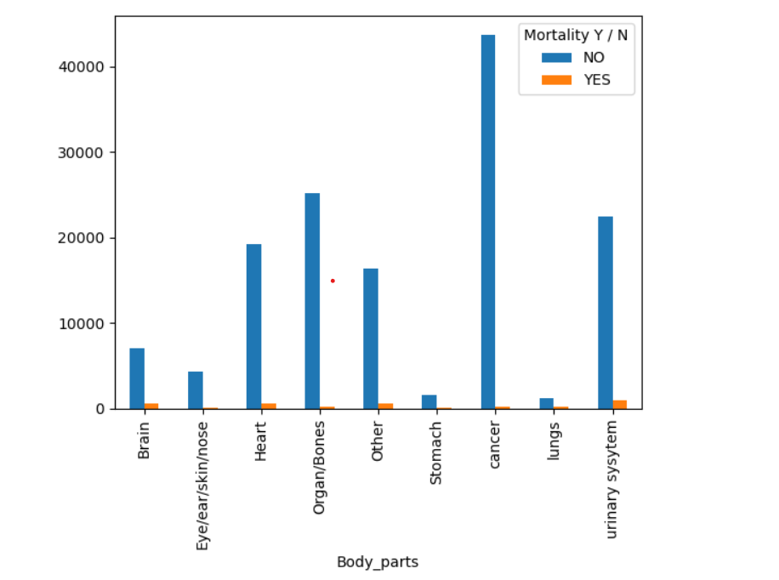
With the help of procedure names , we
Created a new feature which tells us that
The people who had surgeries survived more
From the procedure type column, we found out that
Brain heart and urinary system are the body parts that
Lead to the most causalities.

Slide 14
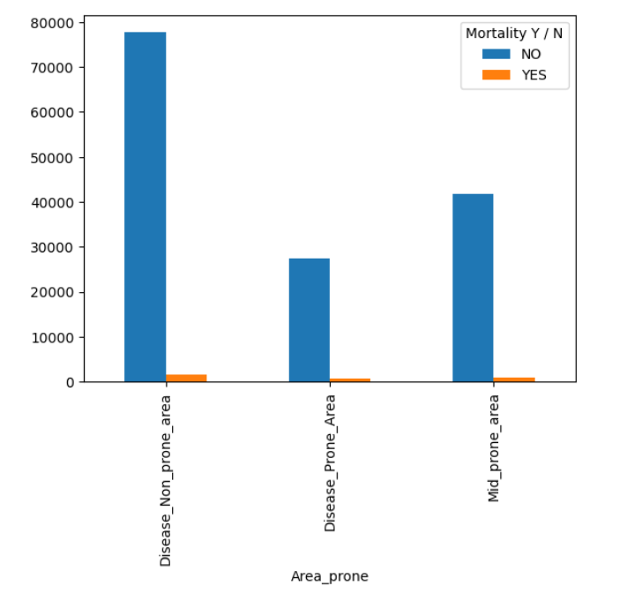
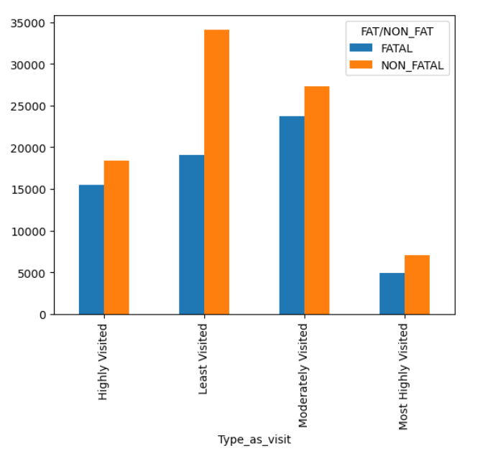
We divided the districts on the basis of
Number of causalities and surprisingly,
The non disease prone areas showed more
Mortalities which is a sign of lack of Infrastructure
In those areas
A new insight was created on the basis of frequency
Of visits of hospitals and the fatality of the disease and
We found out that :
Most highly visited hospitals have less morality which
Means that they are good hospitals and more people
Should be referred there
2. Least visited hospitals are visited for Non Fatal Disease
Which means they need an upgrade on the infrastructure

Slide 15
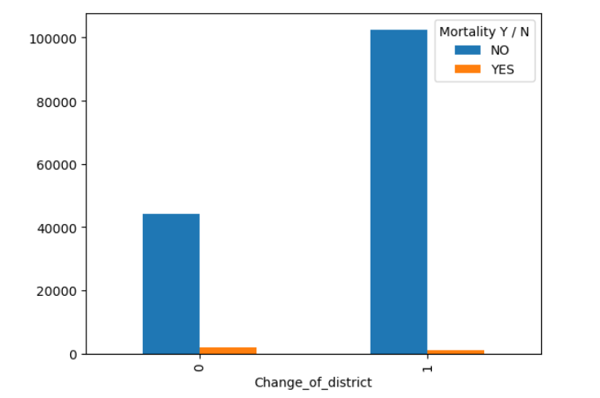
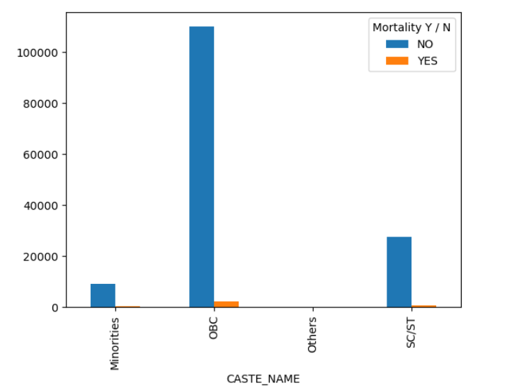
Based on the district of the customer and the district of the hospital , we found out if the Person changed their location to get better facilities or not and we found that people who changed Their districts survived more .
The caste column was refined by combining other
Caste and backward caste as OBC which is a govt
Identified category and this shows a more clear and better
Idea than the previous classification.

Slide 16
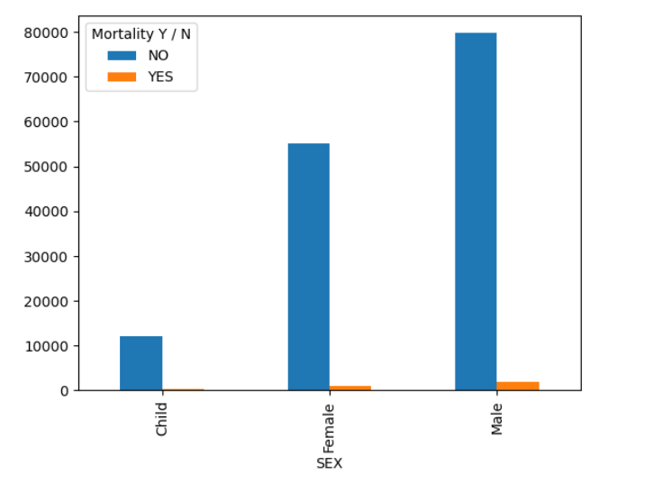
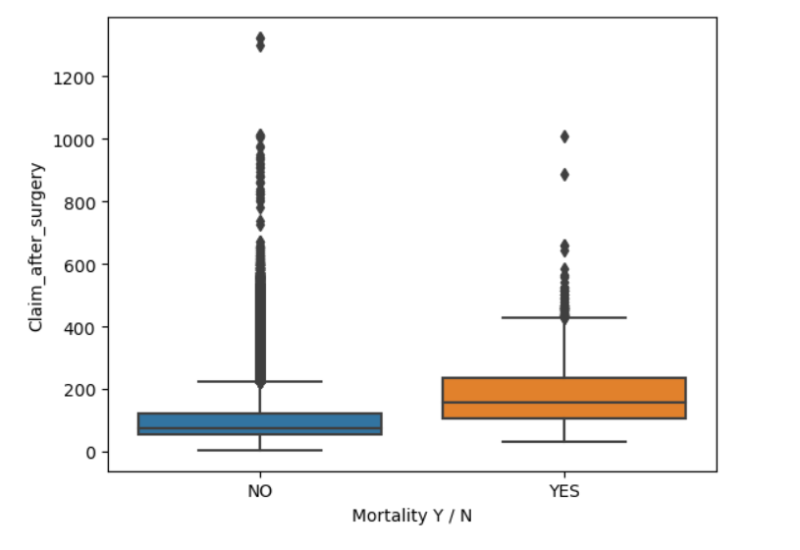
After some careful analysis regarding
The type of surgeries and more , we found
That male and female child have similar patterns
Hence , we combined them and created a more
Model friendly column
After subtracting the surgery date from the claim date ,
We found a column called claim after surgery and found
Out that people who died were provided with a claim later
Tha the people who survived

Slide 17
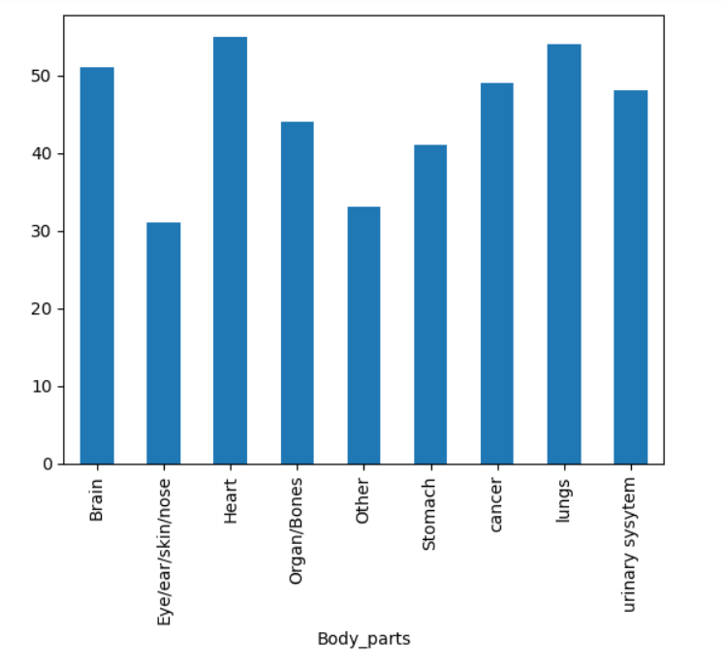
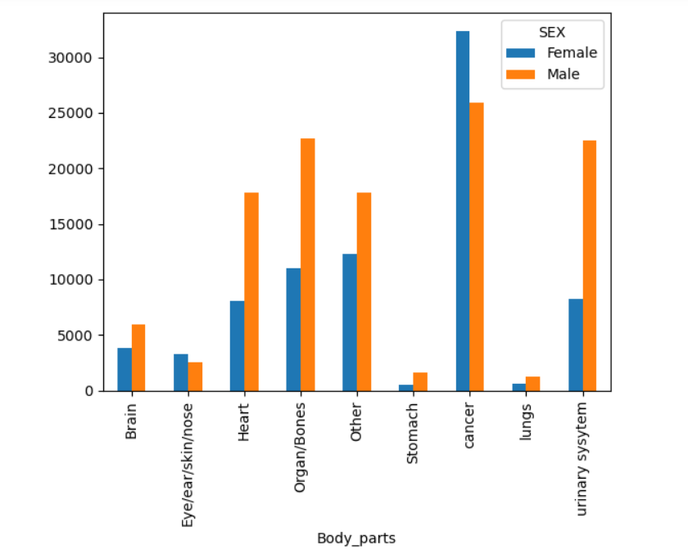
We grouped the body parts column we created earlier by
Age and we can see that heart , lungs and brain diseases
Are occurring to older people, while skin/nose/eyes(ent)
Are occurring to younger people
We grouped the body parts by gender and we found that apart from
cancer., every single disease has more male patients

Slide 18
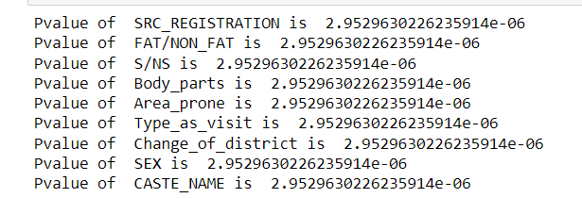
STATISTICS
We applied Statistics on the above data in relation to the target variable i.e mortality and we found out that every column is significant
We can see that all categorical columns are having a significantly lesser value than 5% (generally observed
Value) , hence we can say that all columns are significant

Slide 19
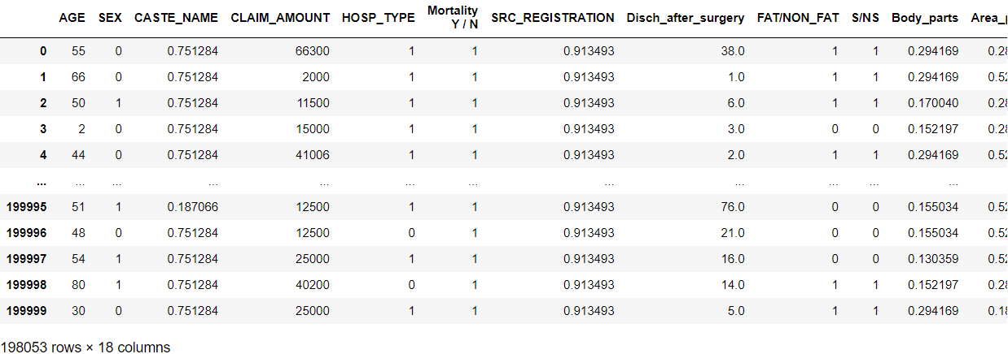
Encoding AND SCALING
As we mostly had categorical columns , which do not even require scaling , so our main task was to encode the different variables but we had a challenge
The challenge was that columns like hospital names had too many categories , while some had lesser like gender, so we decided to go with frequency encoding , and then we normalized the values so that their scales are neither manipulated nor too difficult for the machine to grab

Slide 20
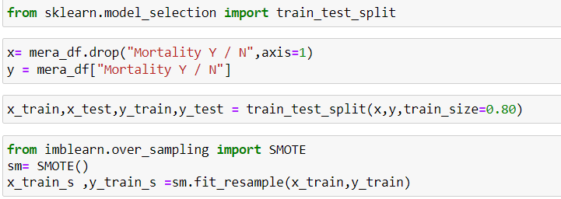
Splitting the data into train and test
We split the data into train and test to check how good our data analysis has been , by training the model on 70% train data and testing it on 30 % test data
But while doing this , we realised that our data is imbalanced ,hence we have to apply a balancing technique , we went with SMOTE

Slide 21
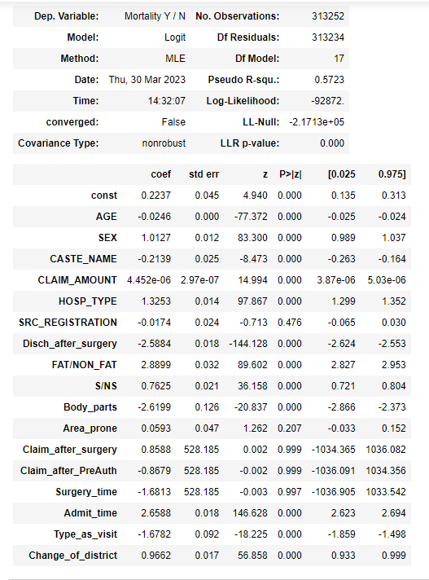
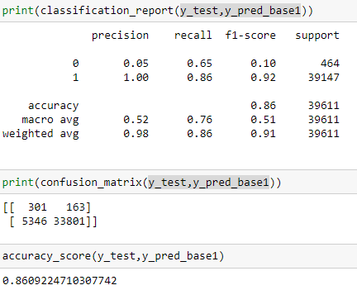
Fitting the base model
As it is a classification problem , we went with the base model as Logit or logistic regression
Here are the Results:
With an accuracy of 86 , this seems very good already but
We can improve this, as the false 0 and 1 are high

Slide 22
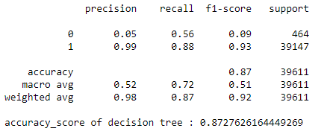
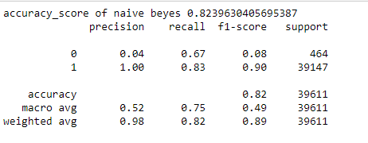
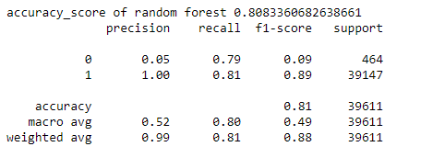
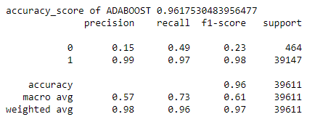
Other models:
# DECISION TREE:
# NAÏVE BEYES:
This is already a better fit than the base model, let
Us try more if we can find even better ones
This is already a better fit than the base model, but inferior
To Decision tree, let Us try more if we can find even better ones
# RANDOM FOREST:
# ADABOOST:
This is already better than base model, but not As good as
DT let Us try more if we can find even better ones
This is a highly overfit model , let
Us try more if we can find even better ones

Slide 23
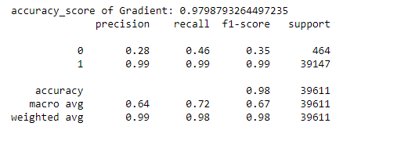
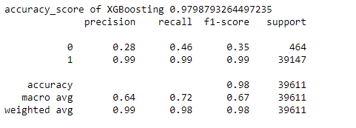
Highly overfit model hence we are rejecting the
Gradient Boosting Model
Highly overfit model hence we are rejecting the
XGBoosting Model

Slide 24
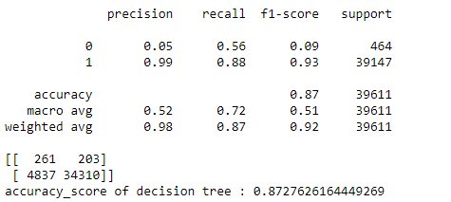
FINAL MODEL: DECISION TREE CLASSIFIER
With the precision , f1 and recall all above 88,
An accuracy of 87%
And with the least false positives and false negatives
We can say that this is the besr model that we could
Have applied on the data .

